Slide 1
Pomeroon Women Agro-Processor Association, Guyana Coconut Oil production Rosemund Benn, President,
Brussels Briefing, 17 September 2015

Slide 2
Pomeroon Women’s Agro-Processors Association
5 hrs from Georgetown
Remote region

Slide 3
Pomeroon Women’s Agro-processors Association
Formed 2001 registered 2002
14 Women, wives and single mothers
Working 3 days/week volunteering
Processing Starfruit to make into cakemix
Sold to raise funds and each contributed Guyana $20k working capital

Slide 4
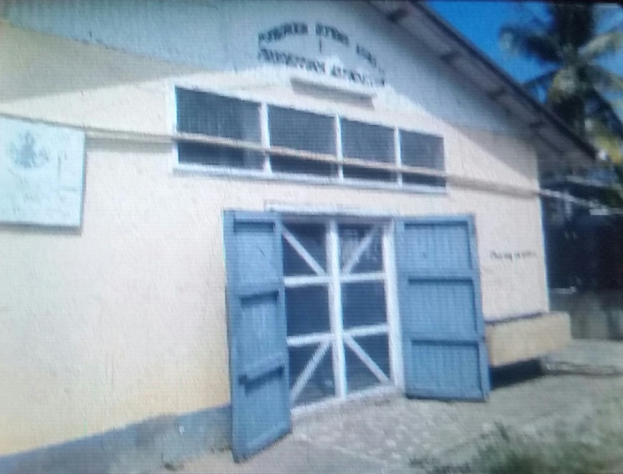
Local Govt donated unused building but it needed renovation with help of CIDA and IFAD
2006: Acquire Certification and licensing to sell products
2007: Started paying the ladies working in the premises
Four products: Starfruit cakemix, seasoning sauce, hot pepper sauce & fruit wine

Slide 5
Capacity building
Through IICA
Management
Food preparation, sanitisation
Brand development – Pomeroon Delight
Ministry of Agriculture support
Assisted with exhibitions e.g. Guyana International EXPO since 2009 and marketing
Voluntary Service Overseas
Volunteers to work with the project
Business record keeping
Developing labelling, Packaging and Marketing
2010 UN Barbados meeting
Virgin coconut oil wins prize which contributed to product development

Slide 6
Network
WADDNET
Formed National network as part of CANROP July 2011 Women agroprocessors development network
CANROP
Rural women Producers Association has supported with training on advertising and marketing online and networking
http://canrop.com

Slide 8
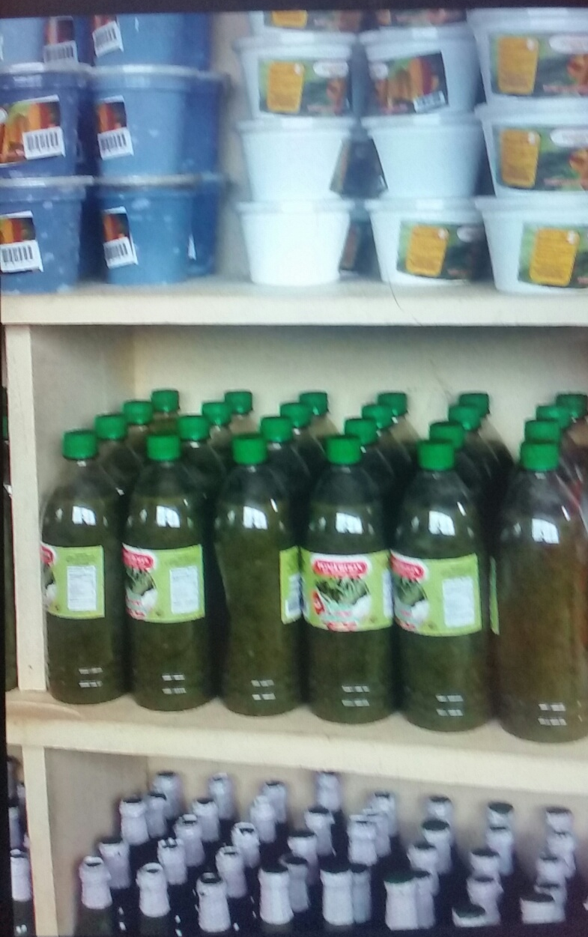
Products today
Starfruit cakemix,
Seasoning suce,
Hot pepper sauce
Fruit wine
Green seasoning
Green Mango Achar
Virgin Coconut Oil

Slide 9
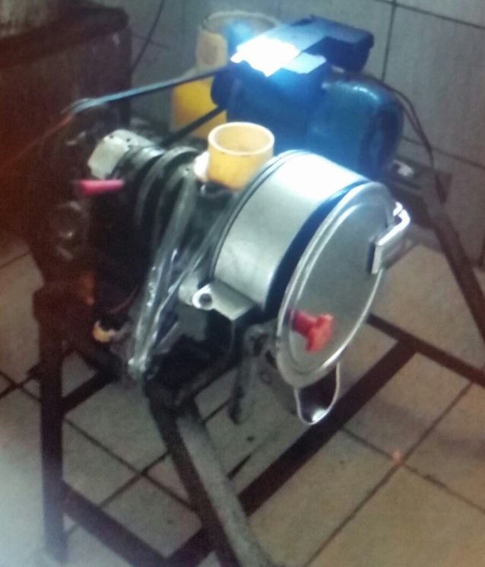
Scaling up
Guyana $4million
Addition to building
Trucks
But still need
New fireplace needs extra funding
Equipment – to replace kitchen equipment

Slide 10
Staffing and sharing revenue
Four members working full-time
Assisted by others at rush times
End of year profit from sales divided and shared among members reserving enough to run business.
Impact on women economic independence and decision-making (travel here for sharing experience...)

Slide 11
Markets
Today we serve 5 supermarkets and over 100 small shops locally from a start of 5 shops in 2002
Guyana $600,000 - $800,000 per month
Main expansion over the last 5 years due to recognition of Pomeroon Delight brand
Currently 10% of all our Pomeroon Delight products are sold at Guyana Shop in Georgetown (shop controlled by Guyana marketing corporation)

Slide 13
Future plans
Purchase of own vehicle
Expand marketing to other supermarkets in Georgetown and the Caribbean region (for virgin coconut oil, we started selling to St Vincent last year and Antigua last month)
Plans to increase to 20 members (attracting young women entrepreneurs) in the next 3 years
Add three new products (jams, jellies, plantain and corn flower)
Need for computer literacy (computer currently use for record keeping only)

